Slide 1
History of Computer Programing
By Tyler Raeside

Slide 2
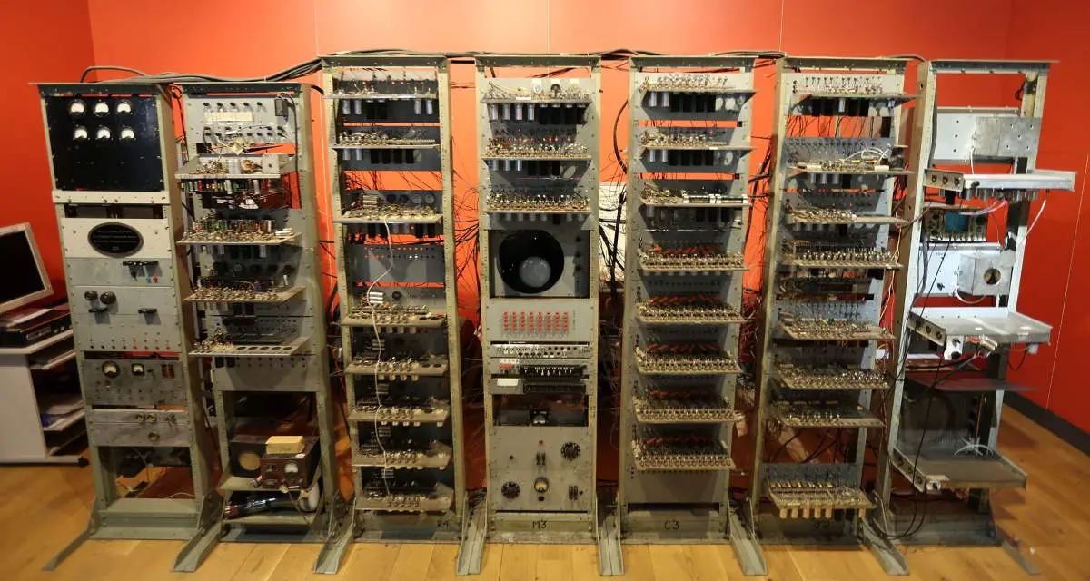
What is a program?
A computer program is a set of instructions that are used to execute tasks to get specific results. A computer memory is where programs that carry out different tasks are stored. The idea to store programs internally was proposed in the late 1940s by the Hungarian-born mathematician John von Neumann. The first digital computer designed with internal programming capacity was the “Baby,” constructed in Manchester, England in 1948.

Slide 3
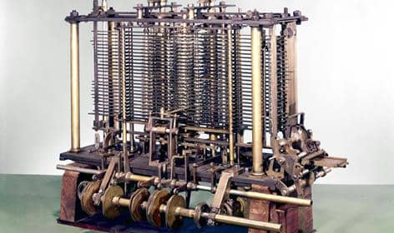
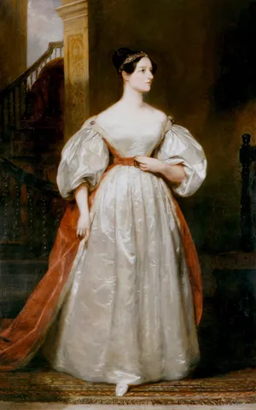
Ada Lovelace
Ada Lovelace was a pioneering mathematician and writer, best known for her work on Charles Babbage's Analytical Engine, an early concept for a mechanical general-purpose computer. She was the first to realize that the machine could do more than just calculations. It could follow a sequence of instructions, making her the world's first computer programmer

Slide 4
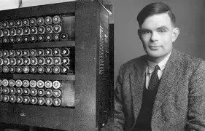
Who is Alan Turing?
Alan Turing was a brilliant British mathematician, logician, and computer scientist who played a huge role in the development of computer science and AI. He is best known for his work in World War II, where he helped break the German Enigma code, greatly helping the Allied war effort. His idea of the Turing machine laid the foundation for modern computing. A Turing machine is a simple theoretical model of a computer that follows logical rules to process information. Despite his contributions, Turing faced persecution due to his homosexuality, which was illegal in Britain at the time. He was convicted in 1952 and subjected to chemical castration as an alternative to imprisonment.
Alan Turing(Right), Turing Machine/Enigma Code Breaker(Left)

Slide 5

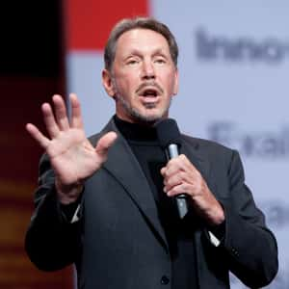
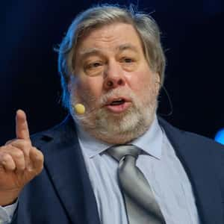
Famous Devs
Sergey Brin: Sergey Mikhaylovich Brin born August 21, 1973 is an American computer scientist and Internet entrepreneur. Together with Larry Page, he co-founded Google.
Larry Ellison: Lawrence Joseph Ellison born August 17, 1944 is an American businessman, entrepreneur, and philanthropist who is a co-founder and the executive chairman and chief technology officer (CTO) of Oracle Corporation.
Steve Wozniak: Stephen Gary "Woz" Wozniak born August 11, 1950 is an American inventor, electronics engineer, programmer, philanthropist, and technology entrepreneur. In 1976 he co-founded Apple Inc.
Sergey Brin
Larry Ellison
Steve Wozniak

Slide 6
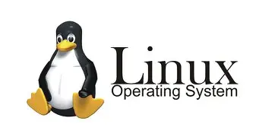
What is Linux?
Linux is an open-source, Unix inspired operating system based on the Linux kernel, which was first released by Linus Torvalds in 1991. It is widely used across various platforms, including servers, PCs, mobile devices, embedded systems, and even supercomputers.

Slide 7
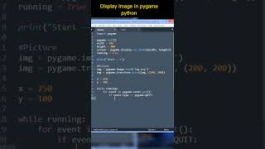
What is python?
Python is a largely used general-purpose high-level programming language. Designed by Guido van Rossum in 1991 and developed by Python Software Foundation. It got the name python because Guido was a fan of Monty Python’s Flying Circus.
Example of a guessing game program:
import random
def roll_die():
return random.randint(1, 6)
if __name__ == "__main__":
print("Rolling the die...")
print(f"You rolled a {roll_die(4)}!")

Slide 8
Evolution of Programing
Over the past six decades, programming has evolved significantly, leading to more advanced and modern programs.
Ada Lovelace, considered the first computer programmer, described an algorithm to compute Bernoulli numbers using Charles Babbage's Analytical Engine.
FoxPro, a programming language for developing database applications was released by Fox Software in 1984.
1956
2025
1843
1984
IBM's John Backus and his team developed FORTRAN (Formula Translation), one of the first high-level programming languages, revolutionizing software development.
Python, Julia, and R leading as AI technologies expand.

Slide 9
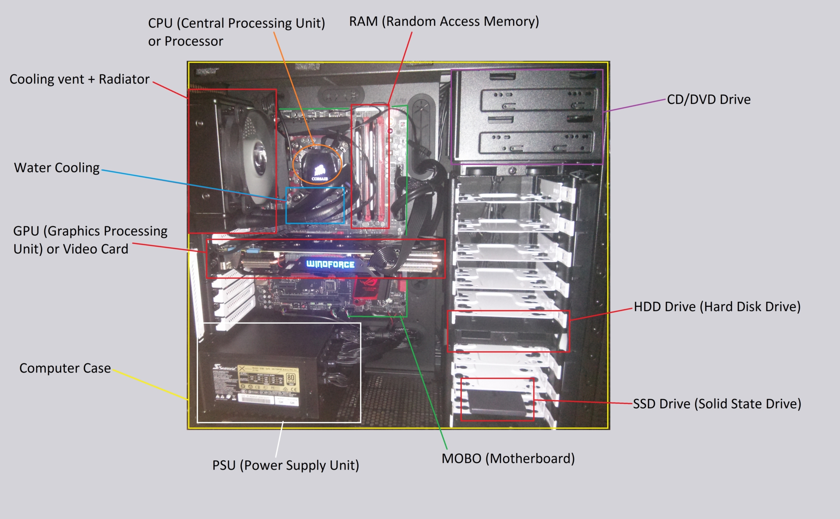
Hardware
Hardware are the guts of a computer the physical components of a computer or any electronic device. This includes things like
the central processing unit (CPU), memory
(RAM), storage devices (hard drives, SSDs),
motherboard, graphics card, and keyboards,
mice, and monitors. Basically anything you
Can touch is hardware.

Slide 10
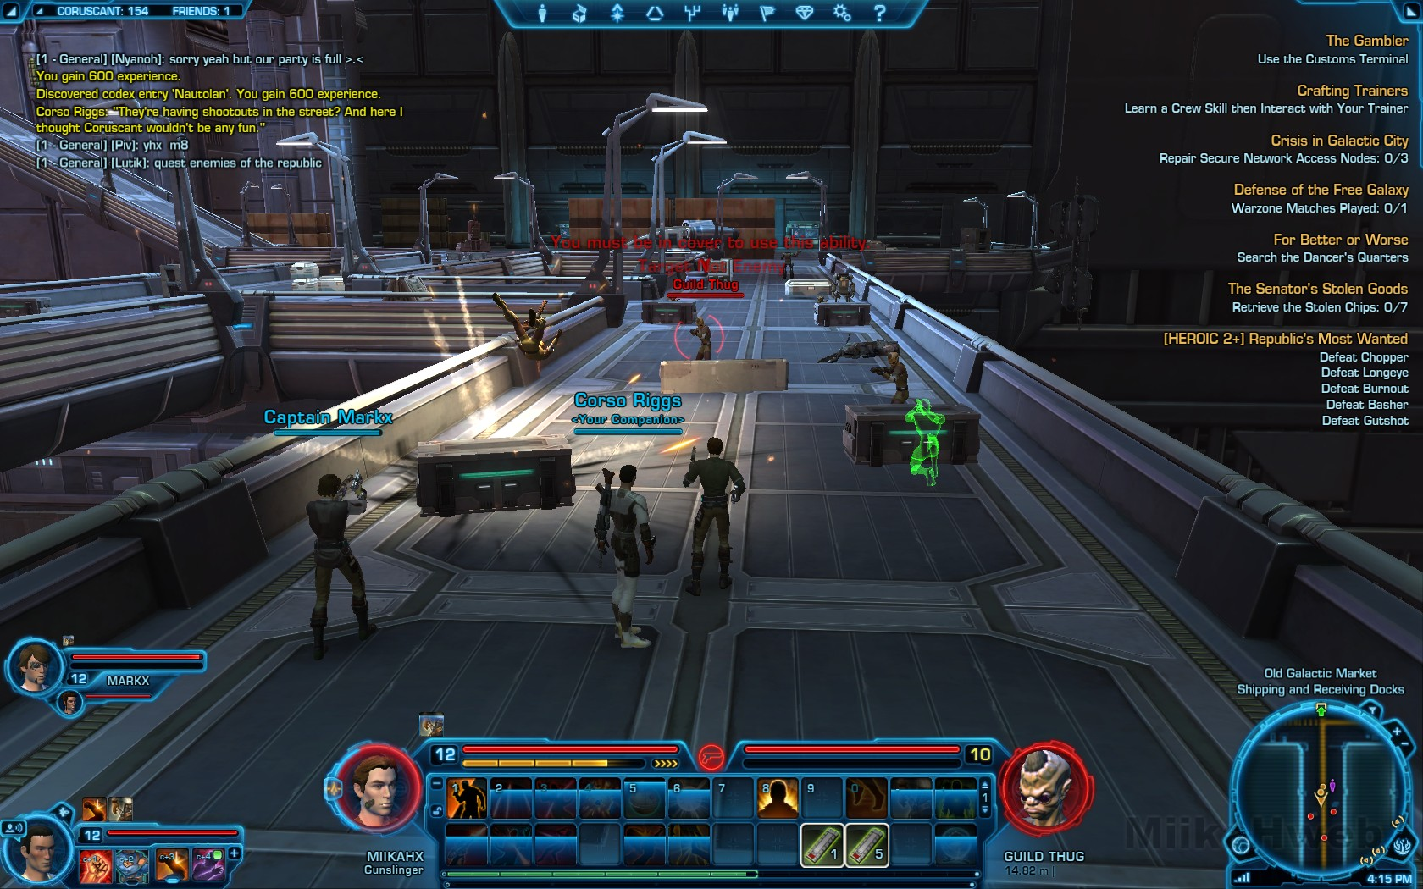
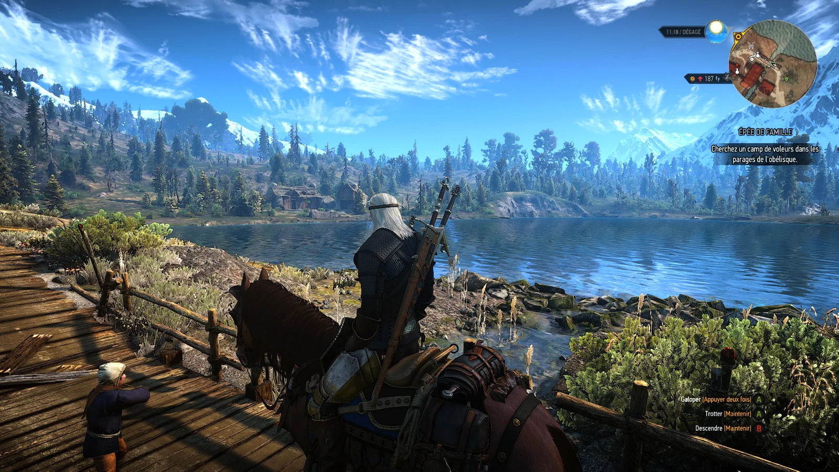
Impact on The Video Game Industry
Programming advancements have allowed developers to create stunningly realistic graphics, intricate game mechanics, and vast open-world environments. Think about how games evolved from simple pixelated graphics to hyper-realistic 3D worlds powered by advanced physics engines. Thanks to modern programming languages and engines like Unity and Unreal Engine, developers can create games that run smoothly across multiple platforms—PC, console, and mobile—without needing to rewrite the code from scratch.

Slide 11
Sources Used
History of Python | GeeksforGeeks
History of Linux [A Complete Overview] - LinuxSimply
Alan Turing: Creator of modern computing - BBC Bitesize
What is a Computer Program? | GeeksforGeeks
What is Linux? - Linux.com
Ada Lovelace | Biography, Computer, & Facts | Britannica
Computer Programming History
Programming Trends 2025: Insights and Predictions | Aegona

